Slide 2
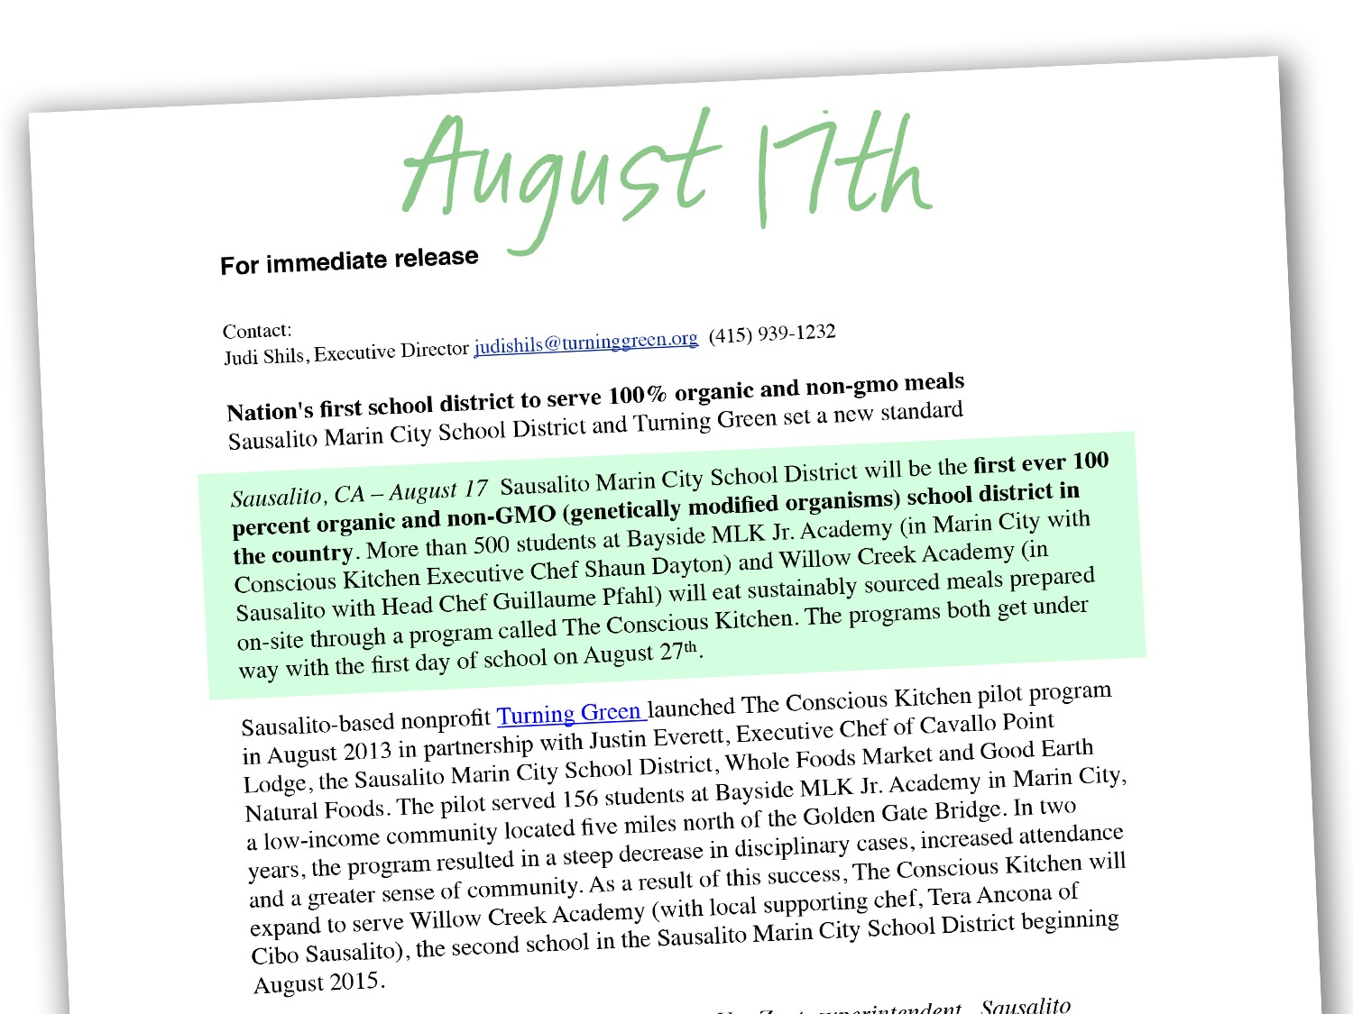

Slide 4
Press Highlights
They all note that this is the first school district in the nation to achieve this milestone
It’s all thanks to the hard work and commitment of staff at Bayside MLK Academy

Slide 5
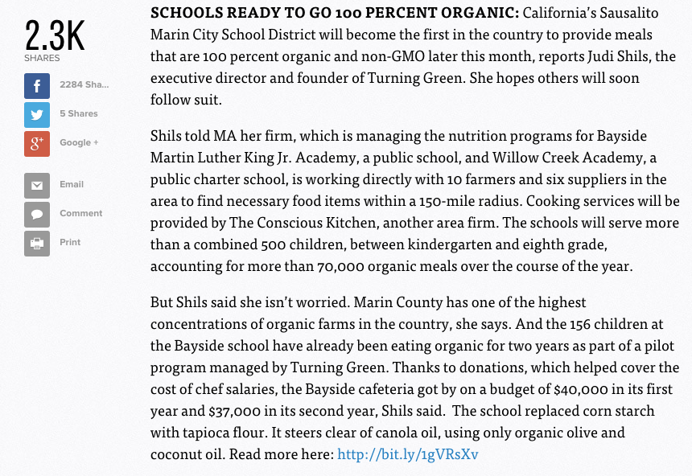
Politico - 2.3K shares

Slide 6
Facebook

Slide 7
EcoWatch - 19K shares

Slide 8
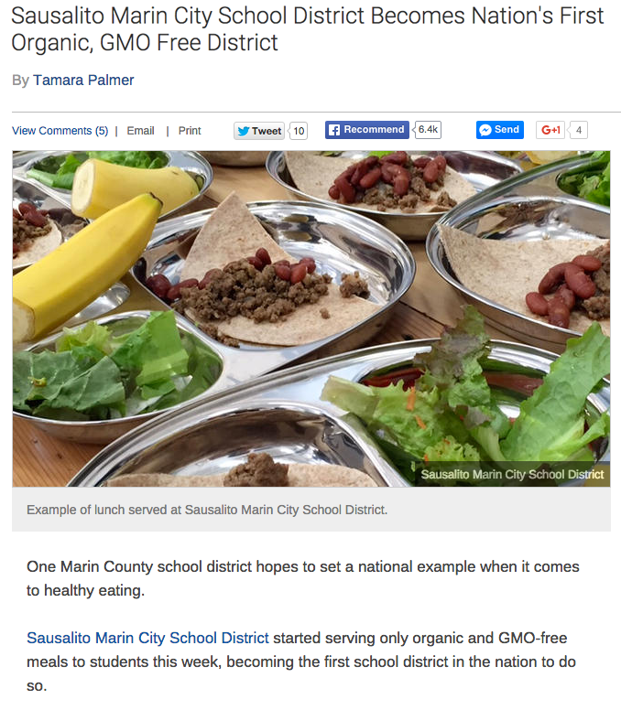
NBC - 6.4K shares

Slide 9
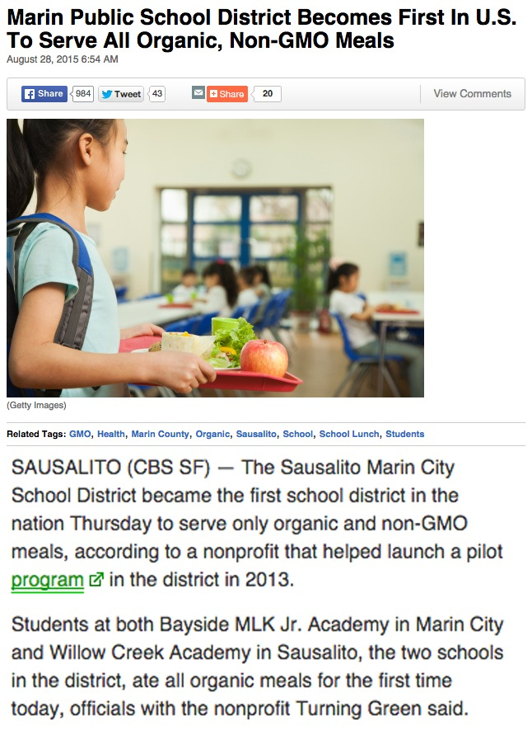
CBS - 900 shares

Slide 10
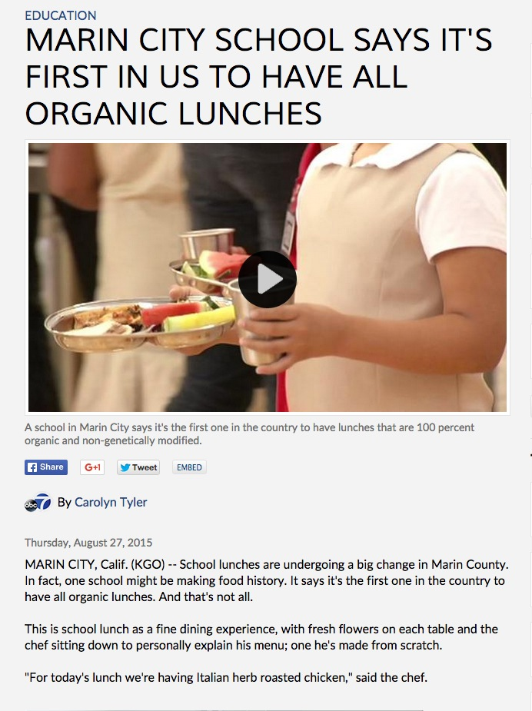
ABC - on site story

Slide 11
Organic Authority - 6K shares

Slide 12
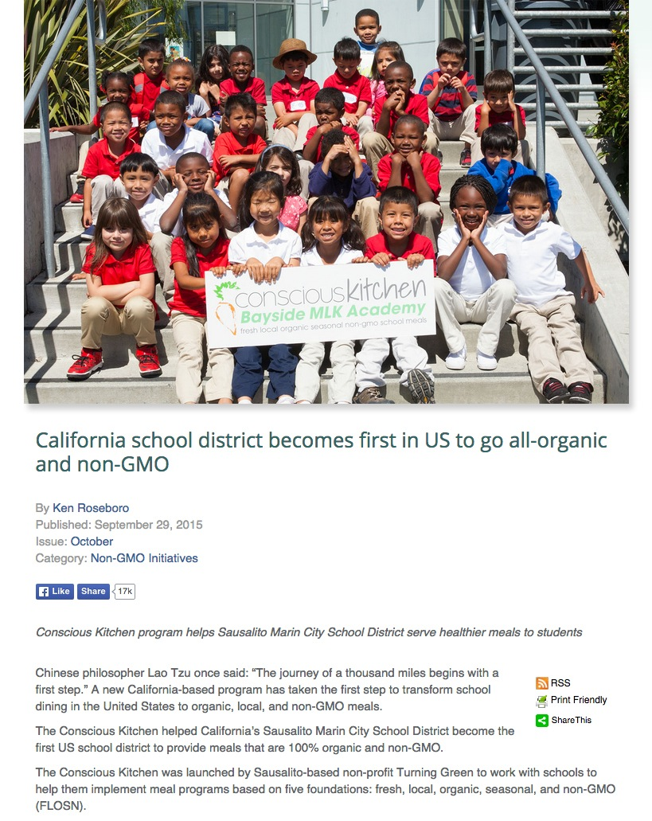
The Organic and Non-GMO Report

